Slide 1

Sentiment Analysis With NLP On Twitter Data.
A work of:
Md. Rakibul Hasan(hasanrakib373@gmail.com), Maisha Maliha(mahimaliha10@gmail.com), M. Arifuzzaman(arif@iict.buet.ac.bd)
From:
Department of Electronics and Communications Engineering, East West University, Dhaka-1212
Bangladesh University of Engineering and Technology, Dhaka-1000.
Presented By:
Kenneth Xavier Dsilva (10600644@mydbs.ie)
At:
Dublin Business School, Dublin 2

Slide 2
Contents:
What’re they talking about?
This section will provide a simple business understanding of this paper.
What’re they proving?
This section will provide the benefits of the paper.
What’s their Aim?
This section will shed light on the probable end goal.
What’s their Approach?
This section will help you understand the road-map their used to reach their Aim.
What did they Find?
This section compares their prediction to reality.
What did they Prove?
This section assesses the work.
What difference does it Make?
This section pin-points the influence on us.

Slide 3
What’re They Talking About?
To Answer this Question, we need to understand two major Aspects.
What is NLP and Why is it prominent here?
NLP or Natural Language Processing is a specific branch of Artificial Intelligence that gives a machine or computer the ability to understand text and spoken words(audio) in a similar way as a human can⁽¹⁾.
In Simple terms, it’s a set of instructions for a computer to understand and interpret human speech and words.
Secondly, there isint any other technique invented yet that can understand and interpret words and audios and use it for analysis. For instance, Automation Anywhere, UI Path and many such applications are present today that can convert an image, pdf or audio into words, however they cannot interpret or analyze it. It can only display the result.
Why do we need to Analyze Twitter? Is it worth the time and energy?
The impact of Twitter can be clearly seen in one major section of our society- The Government. There is a detailed study that proves that during an election campaign a politician actively using his/her Twitter account to spread awareness always receive more votes than who don’t⁽²⁾.
The negative impact is also seen when many Science journals began proving and issuing letters and publishing websites on how the 2017 election in the United States were influenced by Bots on Twitter⁽³⁾. Bots that were dormant as sleeper cells from the very beginning of 2008 and were deployed to influence the election solely.
Hence, it can clearly be seen that just in one sector the Twitter platform can be so powerfully used and even misused. Considering other avenues will prove its relivence even more. Therefore, yes it is Worth Our Time and Effort!

Slide 4
What’re they proving?
One of the major misconception of NLP is that it is fairly new or a latest invention. NLP began taking shape during the second world war to decode German Messages. And ever since NLP has improved exponentially.
The creators of this paper are set out to prove that with words and emojis used in a Tweet or a set of Tweets we can understand the Authors Sentiment during its creation.
Here the creators have chosen to analyze two Top-notched mobile brands; Samsung and Apples iPhone.
They extracted 1000 tweets for Apple and Samsung each and cleaned and prepared them for analyses.
What’s their Aim?
The Aim is simple, compare the sentiment one has about their purchase, review or opinion about an iPhone or Samsung cell phone and compare it with the success and sales in the market.

Slide 5
What’s their Approach?
Load the Model and Classifier
Initialize positive(p=0)
Initialize negative(n=0)
For each Tweet use vectorizer and classifier to predict sentiment
If sentiment[0] == 1->increase Positive else Increase Negative
Twitter API
Create function twitter_api_setup()
Authenticate And Access Twitter keys.
Set argument as iPhone(Samsung) and return the same.
Fetched Tweets
Sentiment Analysis
Serialization & Deserialization
For each tweet create binary bag of words
Split train and test set
Logistic Regression
Pickle the Classifier
TFIDFVectorizer() is used to vectorize
Unpickle.
Convert tweets to list_tweets.
Convert list to dataframe.
Bag Of Words
TF-IDF Model
NLP Pipeline
Classifier Model
Tokenization
Stemming
Lemmentation
Parts of Speech Tagging
Named Entity Recongnition
Dependency Parsing
Subtract Regex
Remove Stop Words.
Preprocessing

Slide 6
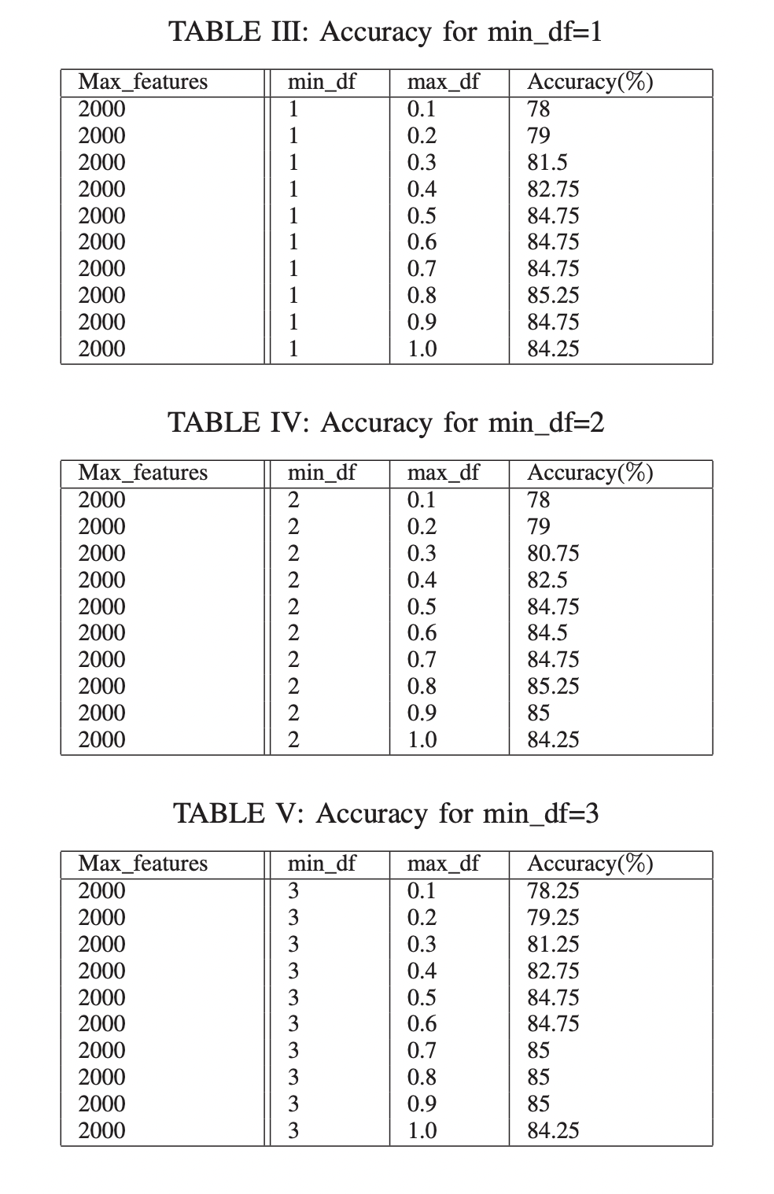
What did they Find?
The major observation in the performance of the algorithm is the use of min_df, that stands for minimum document frequency. This is nothing but the the process of removing the words that are least frequently used. Higher the min_df, more the words removed. Here, three different scenarios we can considered to understand:
Accuracy for min_df = 1, max_df= 0.1
Here all words that appear in less than 1 tweet are removed. Hence, no words are removed from this method. Also, as max_df is set to 0.1 hence, all words that appear in more than 1% of the tweet is removed, again no words are removed. This yields an accuracy of 78% as there are all the words to consider.
Accuracy for min_df = 2, max_df= 0.8
Here all the words that appear in less than 2 tweets are removed and due to max_df all terms that appear in more than 80% of the tweets are removed. This yields an accuracy of 85.25% as many stop terms along with words that are rarely used are removed.
Accuracy for min_df = 3, max_df=1.0
All the words that appear in less than 3 document are removed here and this method seems to work better than the rest with an accuracy of 84.25% for max_df of 1.0. This shows that when all stop words or highly repeated words are removed, the accuracy can drop.

Slide 7
After all the examination and tweaks the team could conclude that:
The accuracy of detection of the sentiment was highest at 85.25% with min_df = 2 and max_df= 0.8.
The sentiments held true with the success of the target mobile brands, where iPhone was more popular and satisfactory compared to Samsung in reality as well as compared to our analysis.
And finally, this method has proven more efficient and effective compared to all previously known algorithms as of July 2019.

Slide 8
What did they Prove?
The researches provided an excellent Study of NLP and exposed the relevance of Tweets in the performance of companies and their products.
Some of their Achievements are:
Creating the only Algorithm that gained an accuracy of 85.25% to predict the sentiment of a tweet using NLP.
Creating an API Call that can allow real-time tweets fetch using keywords (iPhone or Samsung).
Provide graphical representation of positive and negative tweets and compare it with the real-world scenario.
However, there are a few simple advancements and options they could take that would make this process even faster, better and optimized.

Slide 9
What Advancements could be made?
TweetTokenizer() was created in 2016 however was available to use only after March 2020.⁽⁴⁾
TweetTokenizer is a library created for NLTK where token creation is mainly created for the Twitter Platform.
The effect of Twitter on the social and real world has been so affective that this library was maid mainly for it.
TweetTokenizer allows tokenization on tweets as a list and even allows hashtag searches. It also allows emoji emotion detection in a sentence.
For Machine Learning, K-Nearest neighbors performed with an accuracy of 74.74% and Naïve Baised Algorithm produced an accuracy of 82.1%. Also, Logistic Regression was selected as it produced an accuracy of 85.25% which was the best and selected for this purpose.
However, No Bagging or Boosting or Stacking methods were used. Hence, that could come in handy to achieve higher accuracy.
Deep Learning techniques of multi-lingual tweets can be observed creating a wider and better system that can take in tweets from different languages.
The tokenization can easily be done using TweetTokenize combined with WordPunctTokenizer that can make better sense of sarcasm and punctuations used in a sentence.
Also, a neutral spectrum can be added which points out to tweets that are in favour of the target brand yet find scope for improvement and have open complaints about it.
Finally, a rating of tweets depending on users would be helpful. This can create an environment of influential people whose tweet would hold more weightage towards the community rather than they who have fewer followers or a smaller reach. Methods in Neo4j and Graph AI Analysis can help in such situations.

Slide 10
What difference does it Make?
According to a study carried out in June 2020 by Shu Zhang^{[5]} and his team from the university of Twente, Netherlands. Twitter is the largest platform used by Giant Tech and Non-Tech Companies to attract major Stake-Holders.
The number of research work done on Twitter between 2016 to 2021 has been so massive that it compelled Twitter release an Academic Research Product Track, through which for the purpose of research one can gain access to the full-archived search endpoint and not just 7-day old tweets^{[6]}.
Hence, when we can in real-time access full-archived tweets, with no boundaries and add on the newer TweetTokenizer and Machine Learning Algorithms, we definitely have a chance to improve the Algorithm.
Not just that, consider political scenarios or something simpler as betting on the team you think will win a football game and predicting the nature of the final bet depending on the mentality of more than 50million users over the globe.
Differentiating between fake news and real news by users at the center of the action- Russia-Ukraine issue.

Slide 11
References
IBM Cloud Education (2020). What is Natural Language Processing? www.ibm.com. Available at: https://www.ibm.com/cloud/learn/natural-language-processing.
Kruikemeier, How political candidates use Twitter and the impact on votes 2014. Available at: https://www.sciencedirect.com/science/article/abs/pii/S0747563214000302
KUPFERSCHMIDT, KAI. “Social Media “Bots” Tried to Influence the U.S. Election. Germany May Be Next.” Www.science.org, 13 Sept. 2017, www.science.org/content/article/social-media-bots-tried-influence-us-election-germany-may-be-next.
NLTK : Release Notes, 2022, https://www.nltk.org/news.html
Zhang, S., Gosselt, J. F. and de Jong, M. D. T. (2020) ‘How Large Information Technology Companies Use Twitter: Arrangement of Corporate Accounts and Characteristics of Tweets’, Journal of Business and Technical Communication, 34(4), pp. 364–392. doi: 10.1177/1050651920932191.
Parack, S., 2022. Introducing the new Academic Research product track. [online] Twitter Community. Available at: https://twittercommunity.com/t/introducing-the-new-academic-research-product-track/14863.

